Slide 1


Short Course on Using R as a GIS
Dr Nick Bearman
@nickbearmanuk

Slide 2
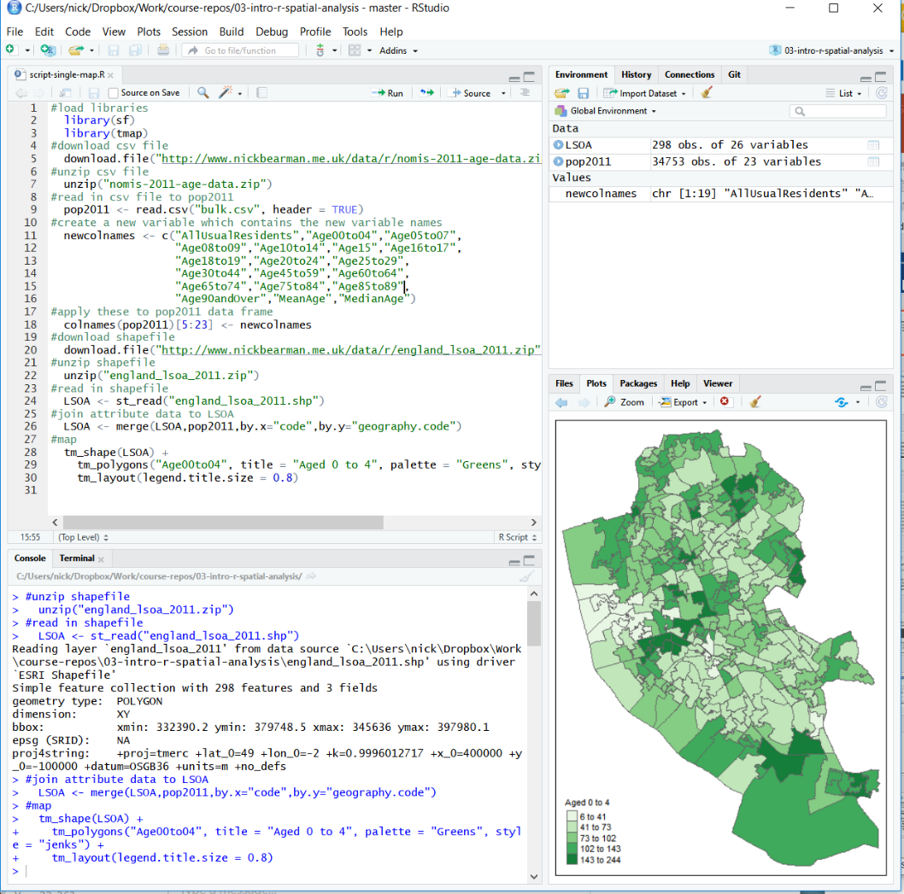
What will you get from the course?
Three Parts:
What is R & how does it work?
Mapping Spatial data in R
Using Loops in R

Slide 3
What will you get from the course?
Three Parts:
What is R & how does it work?
Mapping Spatial data in R
Using Loops in R

Slide 4
What will you get from the course?
Three Parts:
What is R & how does it work?
Mapping Spatial data in R
Using Loops in R

Slide 5
What will you get from the course?
Three Parts:
What is R & how does it work?
Mapping Spatial data in R
Using Loops in R

Slide 6
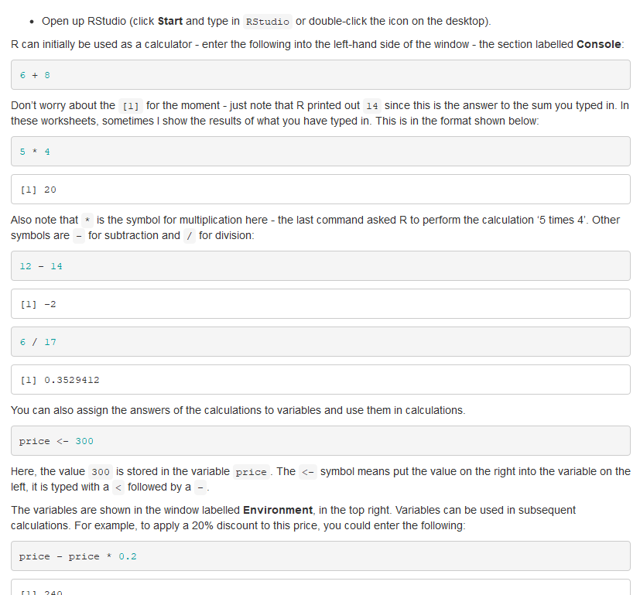
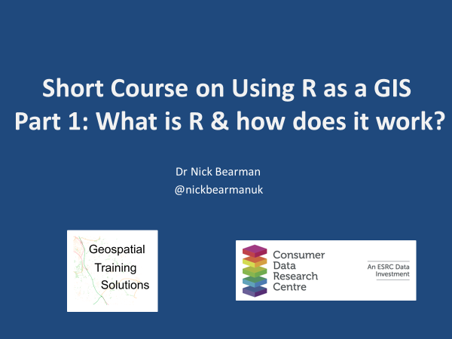
What will you get from the course?
Each part has a video &
Some code

Slide 8
Short Course on Using R as a GIS
Part 1: What is R & how does it work?
Dr Nick Bearman
@nickbearmanuk

Slide 9
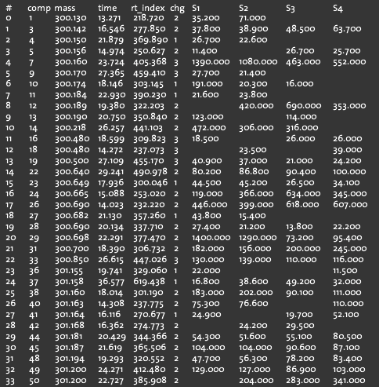
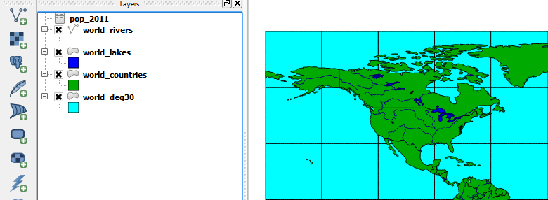
What is GIS?
Geographic Information Systems
Turning (spatial) data into information
Using this information to answer questions
How have housing conditions changed in the past ten years?
http://www.flickr.com/photos/dsleeter_2000/3097476532 & ESRI Course “Teaching with GIS”

Slide 10
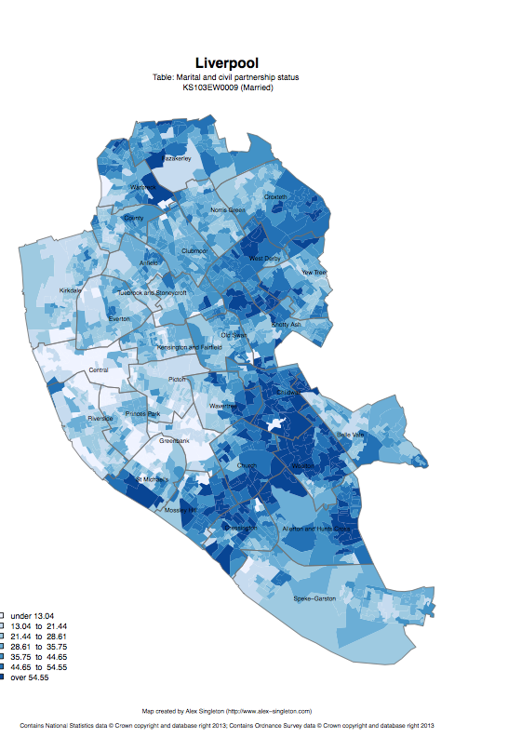
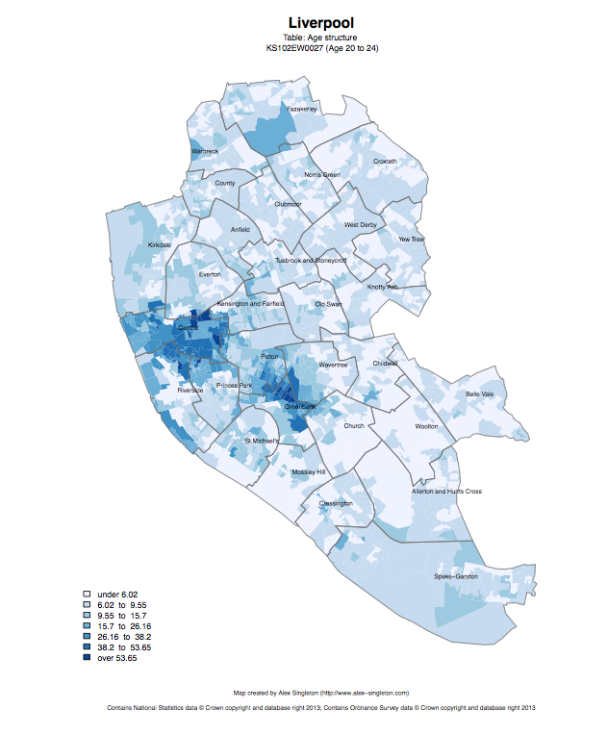
Census 2011
Married
Age structure – 20 to 24
http://www.alex-singleton.com/r/2014/02/05/2011-census-open-atlas-project-version-two/

Slide 11
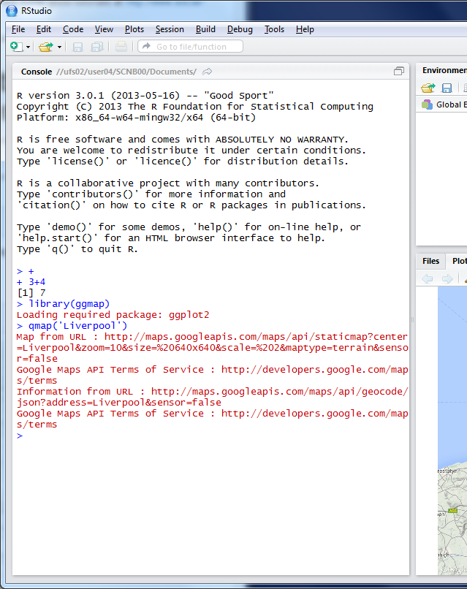
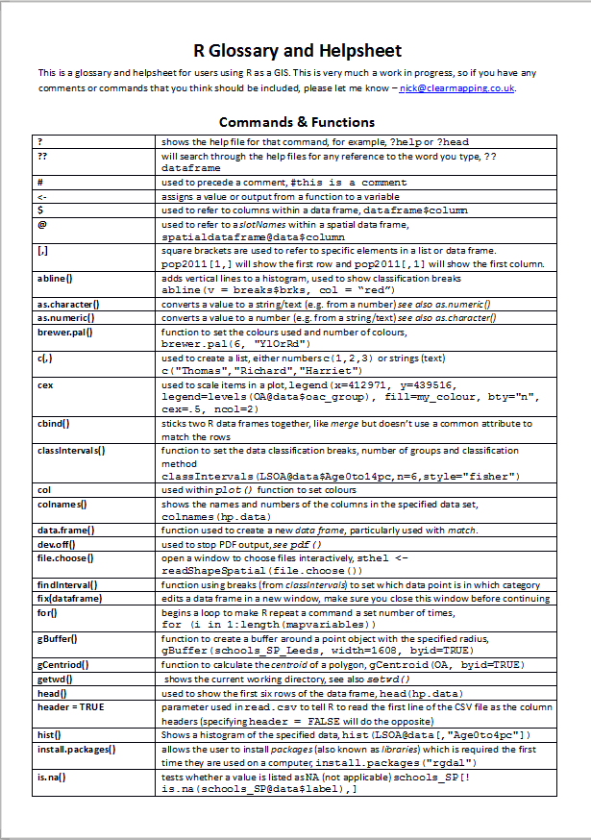

R as a GIS
Command line driven, rather than GUI
Disadvantages
Remembering commands
glossary
Steeper learning curve

Slide 12
R as a GIS
Advantages
Easy to record what you did and repeat specific pieces of work
Lots of reproducible examples on the web
Easily scriptable.
134,567 maps? Easy! (354 areas X ~392 variables)
2011 Census Open Atlas
http://www.alex-singleton.com/r/2014/02/05/2011-census-open-atlas-project-version-two/

Slide 13
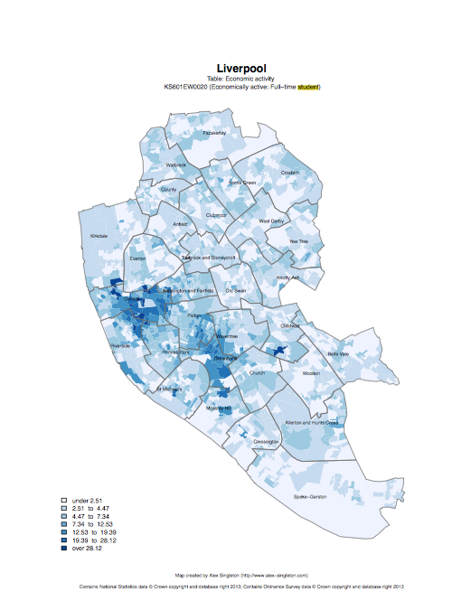

R in Action
Economically active – Full-time students

Slide 14
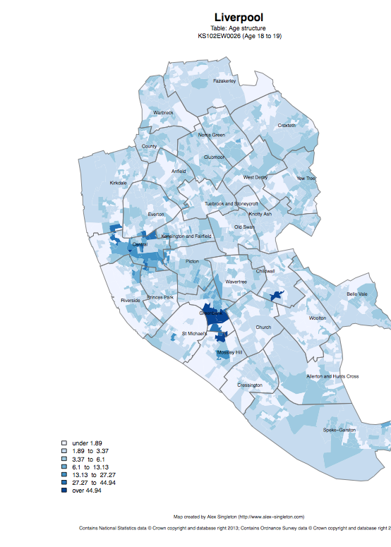
Age structure – 18 to 19
Age structure – 20 to 24

Slide 15
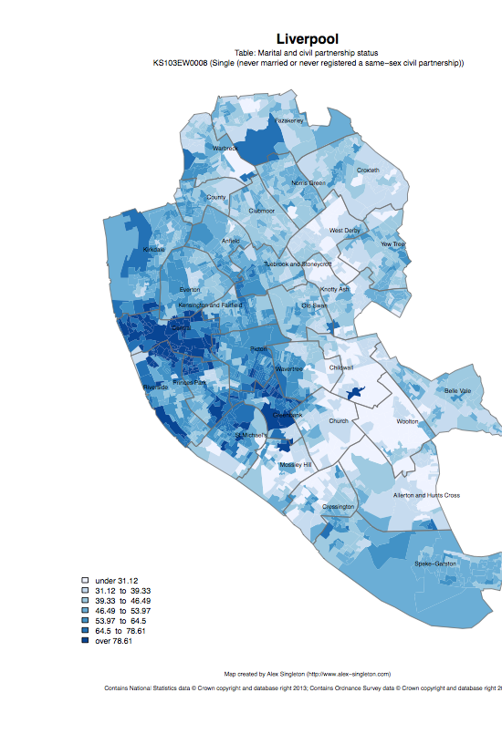
Single
Married

Slide 16
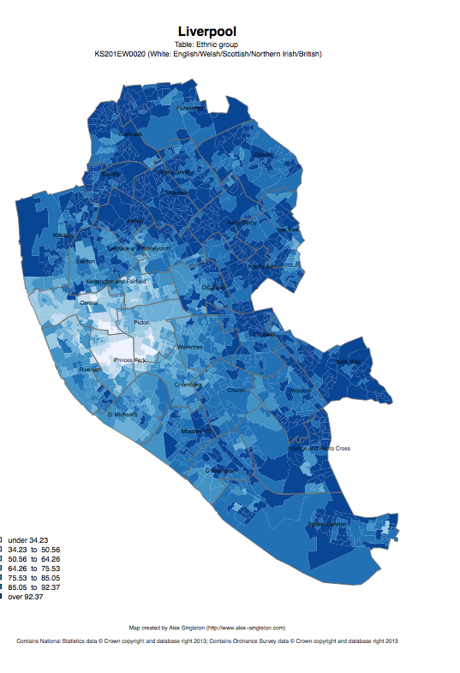
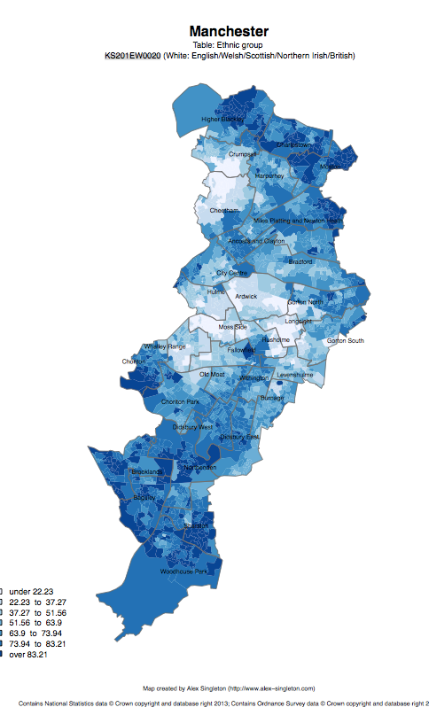
Ethnic group: white

Slide 17
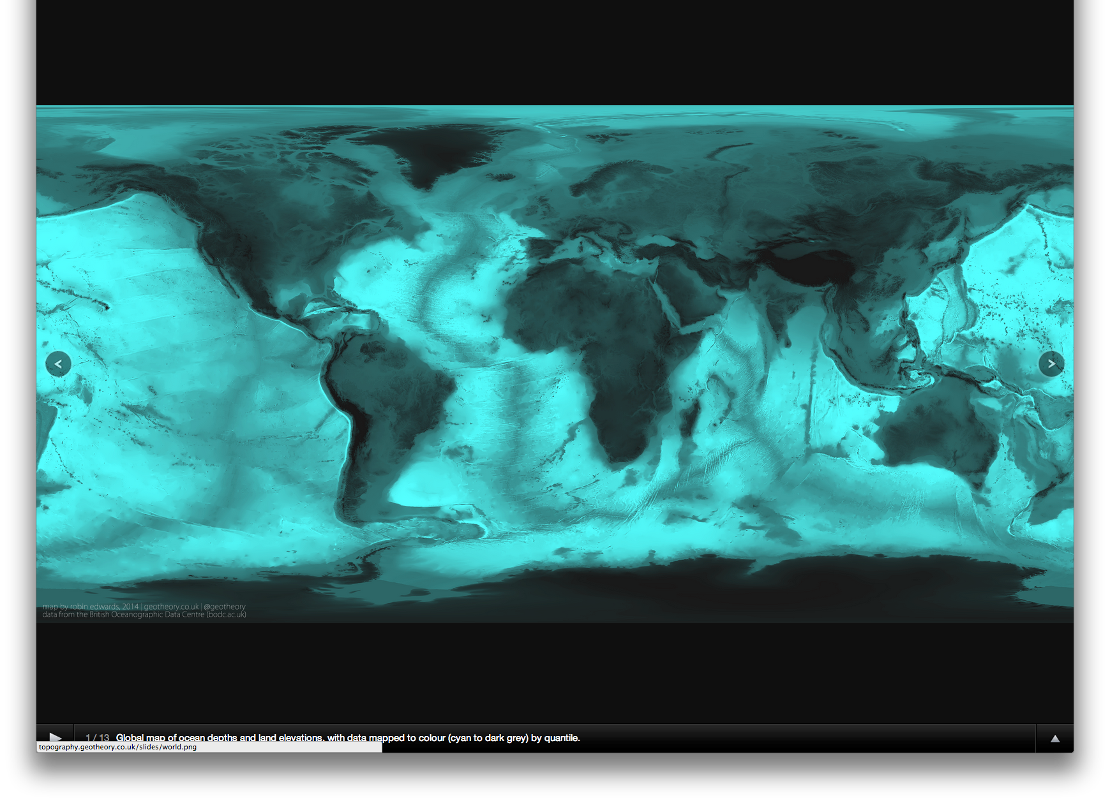

R as a GIS
Topography
http://topography.geotheory.co.uk/

Slide 18
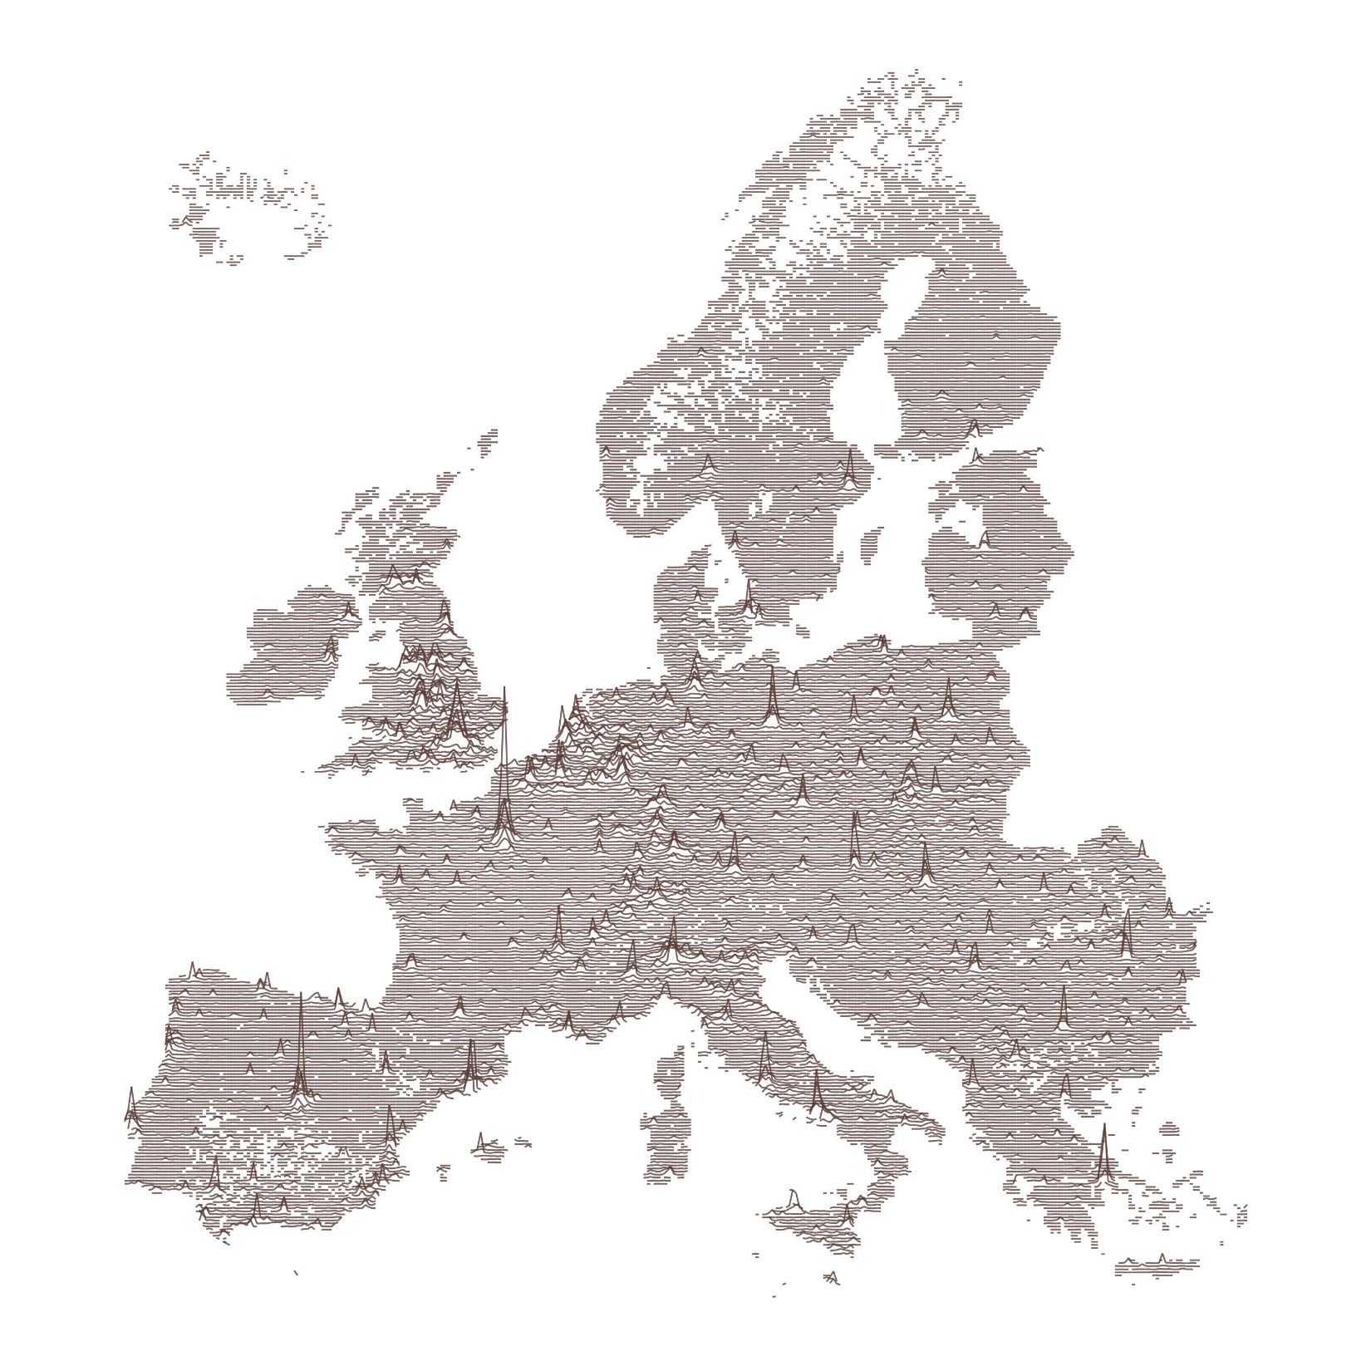
https://gist.github.com/halhen/659780120accd82e043986c8b57deae0

Slide 19
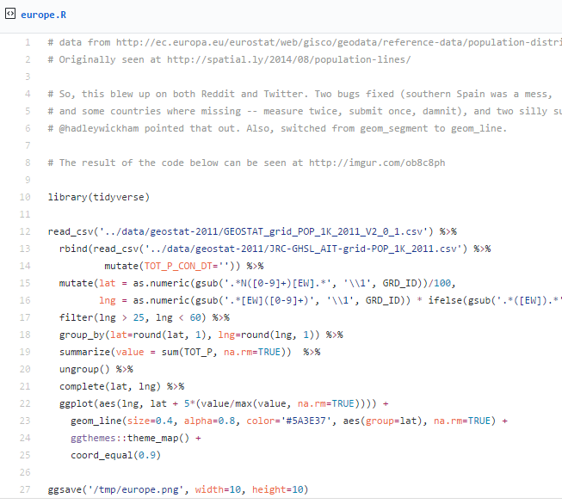
https://gist.github.com/halhen/659780120accd82e043986c8b57deae0

Slide 20




Other GIS software?
R is very different to ArcGIS, but can do many of the same operations
R is free (as is QGIS)
R is increasingly popular in academic sector
Try data in QGIS if you like
All can be useful

Slide 21
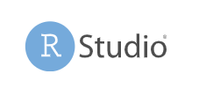
R and RStudio
If you need to install R on your computer
Install R first
Then RStudio

Slide 22
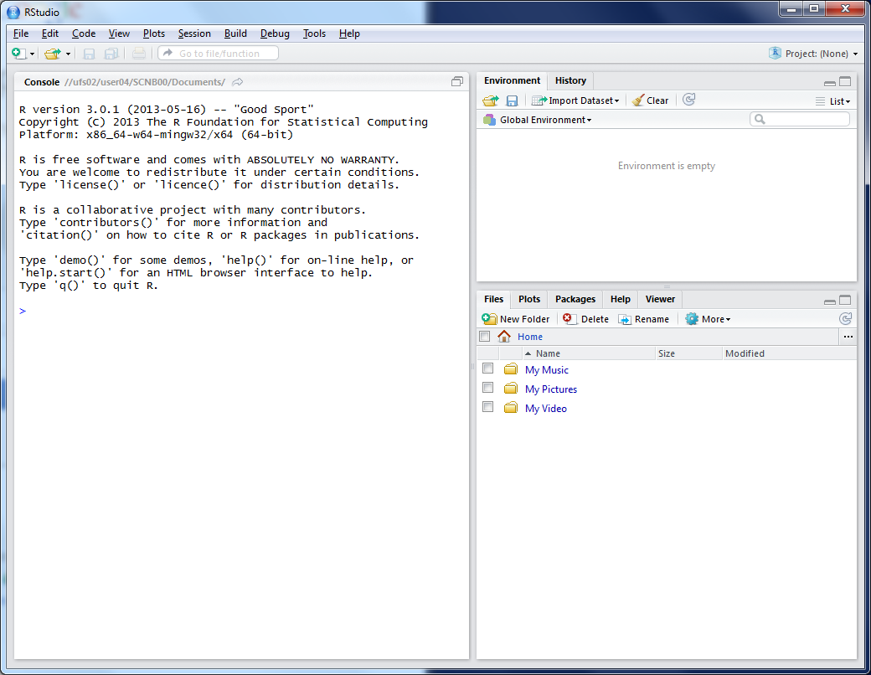
This lists the variables you have
This is the console where you can type in commands
Here will show either your files (the files tab) or your plots (the plots tab)

Slide 23
Working Directory
R uses a ‘working directory’ to store your files in
You might have a different one for each project / piece of work
e.g. C:\Documents\GIS
setwd(“C:/Documents/GIS”)

Slide 24
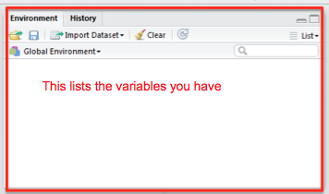
Variables
R uses variables to
store information –
listed in your ‘workspace’ (top-right)
house.prices <- c(120,150,212, 99,199,299,159)

Slide 25
Variables and Assignments
house.prices
<-
c(120,150,212,99,199,299,159)

Slide 26
Variables and Assignments
house.prices
<-
c(120,150,212,99,199,299,159)

Slide 27
Variables and Assignments
house.prices
<-
c(120,150,212,99,199,299,159)

Slide 28
Variables and Assignment
sthelens
<-
st_read("sthelens.shp")
Notes:
28

Slide 29
Variables and Assignment
sthelens
<-
st_read("sthelens.shp")
Notes:
29

Slide 30
Variables and Assignment
sthelens
<-
st_read("sthelens.shp")
Notes:
30

Slide 31
Variables and Assignment
sthelens
<-
st_read("sthelens.shp")
Notes:
31

Slide 32
Variables and Assignment
sthelens
<-
st_read("sthelens.shp")
See glossary for details
Case sensitive
StHelens ≠ sthelens ≠ STHELENS
Notes:
32

Slide 33
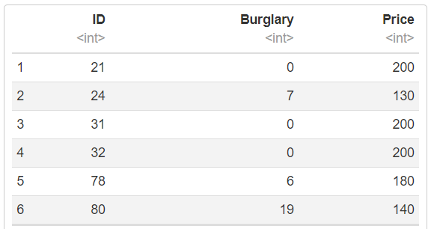
Data Types
R can store data in many different types of variable
Vector:
house.prices <- c(120,150,212,99,199,299,159)
Data Frame:
Notes:
33

Slide 34
Data Types
R can also store different types of data
1,2,3 numeric
“CDRC” character (string)
Can use class() to see what type:
> class(house.prices)
[1] "numeric"
Notes:
34

Slide 35
Data Formats
Data frames are like a table or spreadsheet
dataframe[rows,cols]
dataframe[1,] first row
dataframe[,1] first col

Slide 36
Libraries
R uses libraries to extend what it can do
There are several GIS libraries
If you are using your own machine
You will need to install the libraries
install.packages(“sf”)
You will also need to load the libraries
library(sf)

Slide 37
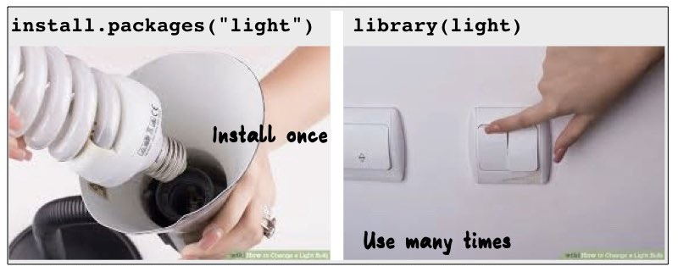
Libraries
R uses libraries to extend what it can do
https://twitter.com/visnut/status/1248087845589274624

Slide 38
Part 1: What is R & how does it work?
Part 1 of the workbook is below.
Have a go working through the commands
Type out the code (don’t copy/paste)
Why do I make you type out code?
Helps the learning process
Make you think about what the code does

Slide 40
Short Course on Using R as a GIS
Part 2: Mapping Spatial data in R
Dr Nick Bearman
@nickbearmanuk

Slide 41
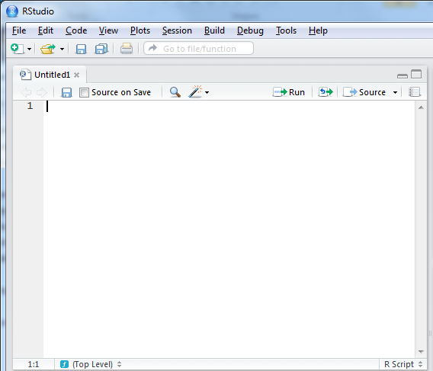
R Scripts
Why use scripts?
Easier to correct code
Can easily re run sections of code, or all code if you need to start again
Good to enable you to reload data etc. if you move machines, or don’t have your workspace saved

Slide 42
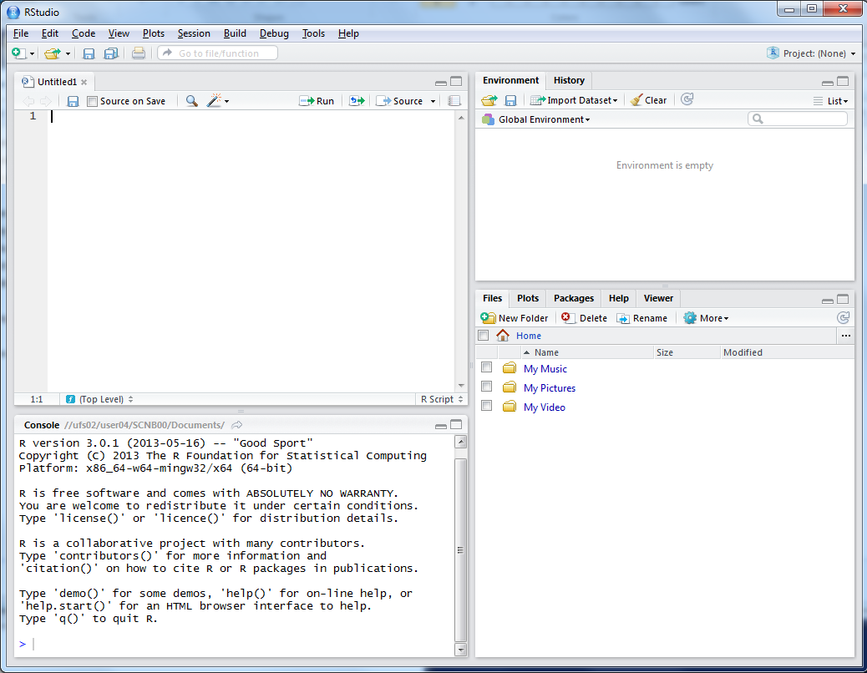
This is where you can write scripts
This lists the variables you have
Link to survey:
Here will show either your files (the files tab) or your plots (the plots tab)
This is the console where you can type in commands

Slide 43
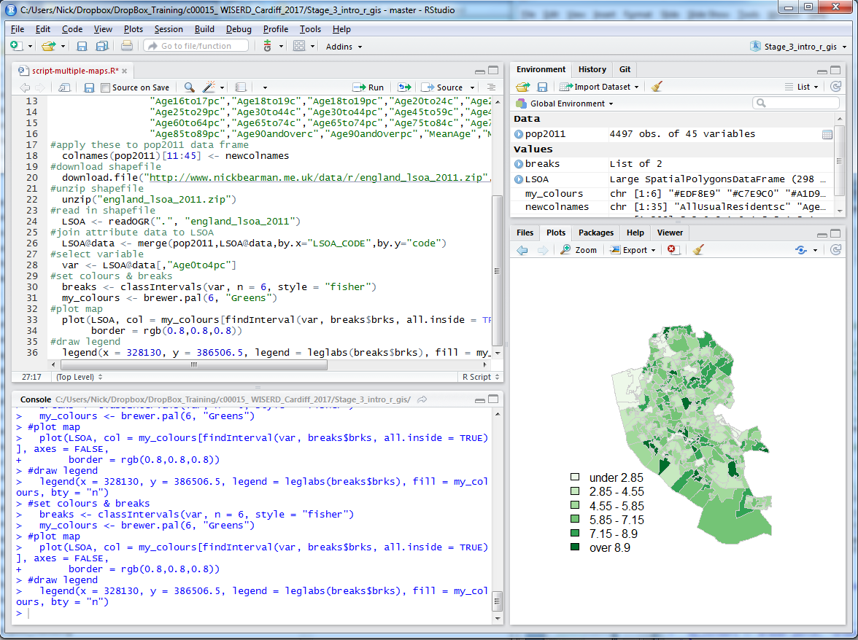

Slide 44
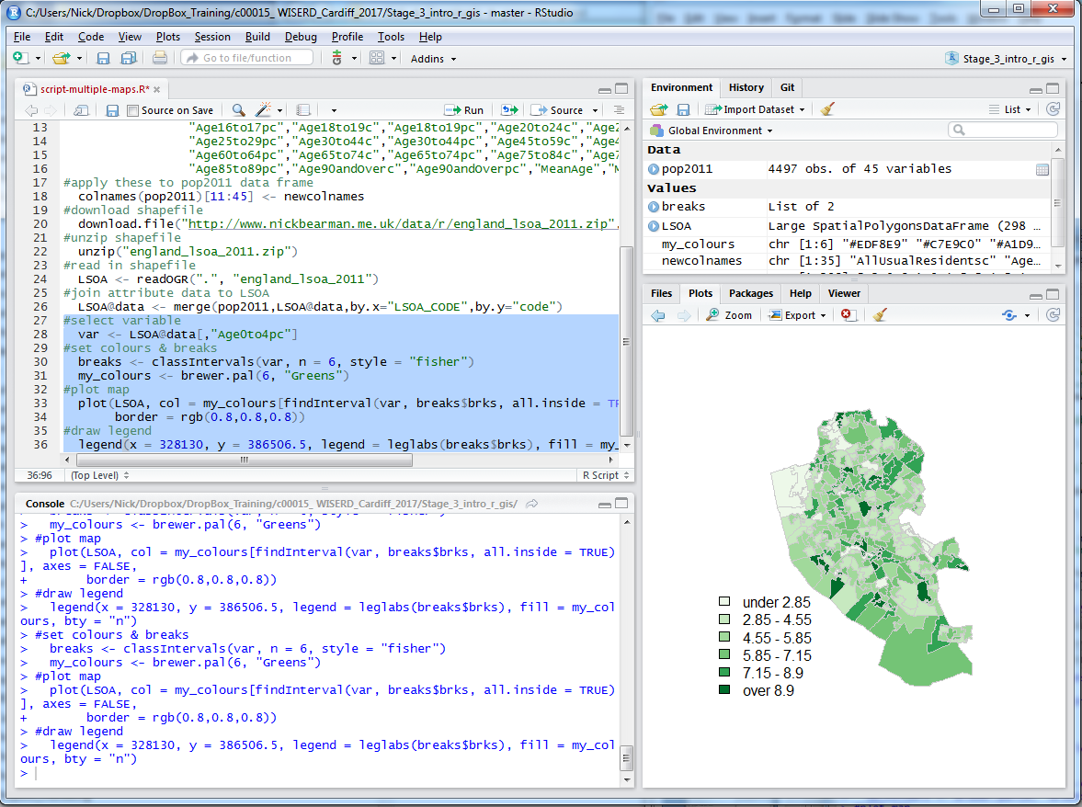
To run script, select lines

Slide 45
Click Run, or Ctrl-Enter

Slide 46
Joining
Area ID | Deprivation | Population
1 | High | 857
2 | High | 952
3 | High | 1098
4 | Average | 1043
5 | Average | 873
6 | Average | 987
7 | Low | 932
8 | Low | 945
9 | Low | 845
10 | High | 945
11 | Low | 1021
12 | High | 1043
13 | High | 1024
14 | Average | 988
15 | Average | 998

Slide 47
Joining
Area ID
1
2
3
4
5
14
7
8
11
1
2
3
14
4
7
5
8
11
Data
Polygons

Slide 48
Joining
Area ID
1
2
3
4
5
14
7
8
11
Area ID | Deprivation
1 | High
2 | High
3 | High
4 | Average
5 | Average
6 | Average
7 | Low
8 | Low
9 | Low
10 | High
11 | Low
12 | High
13 | High
14 | Average
15 | Average
1
2
3
14
4
7
5
8
11
Data
Polygons
Lookup

Slide 49
Joining
Area ID
1
2
3
4
5
14
7
8
11
Area ID | Deprivation
1 | High
2 | High
3 | High
4 | Average
5 | Average
6 | Average
7 | Low
8 | Low
9 | Low
10 | High
11 | Low
12 | High
13 | High
14 | Average
15 | Average
1
2
3
14
4
7
5
8
11
Data
Polygons
Lookup

Slide 50
1
Area ID | Deprivation
1 | High
2 | High
3 | High
4 | Average
5 | Average
14 | Average
7 | Low
8 | Low
11 | Low
2
3
14
4
7
5
8
11
High Deprivation
Average Deprivation
Low Deprivation

Slide 51
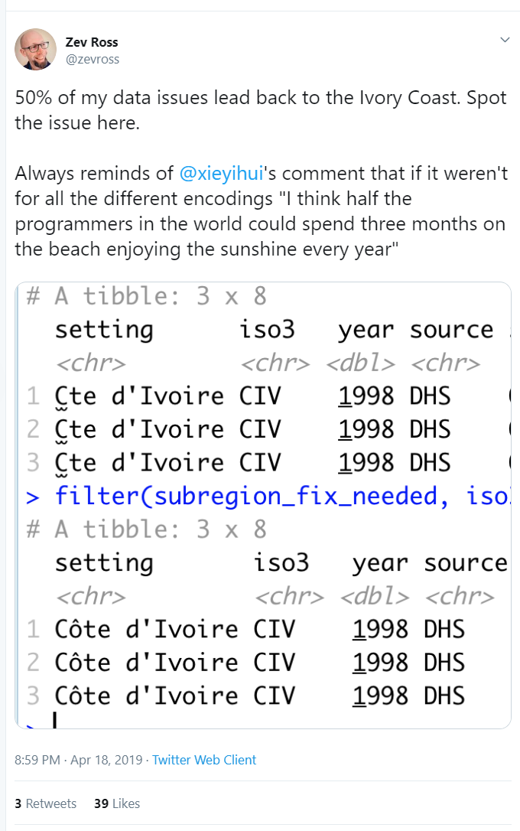
Attribute Join
The attribute is key
It must match exactly
“Gambia, The” ≠ “The Gambia”
“USA” ≠ “The United States”
“UK” ≠ “Great Britain”
“UK” ≠ “UK ”
Codes (ISO3) can help
https://twitter.com/zevross/status/1118967279864242176

Slide 52
Attribute Join
The attribute is key
It must match exactly
“Gambia, The” ≠ “The Gambia”
“USA” ≠ “The United States”
“UK” ≠ “Great Britain”
“UK” ≠ “UK ”
Codes (ISO3) can help
https://twitter.com/zevross/status/1118967279864242176

Slide 53

The attribute is key
It must match exactly
“Gambia, The” ≠ “The Gambia”
“USA” ≠ “The United States”
“UK” ≠ “Great Britain”
“UK” ≠ “UK ”
https://twitter.com/zevross/status/1118967279864242176

Slide 54
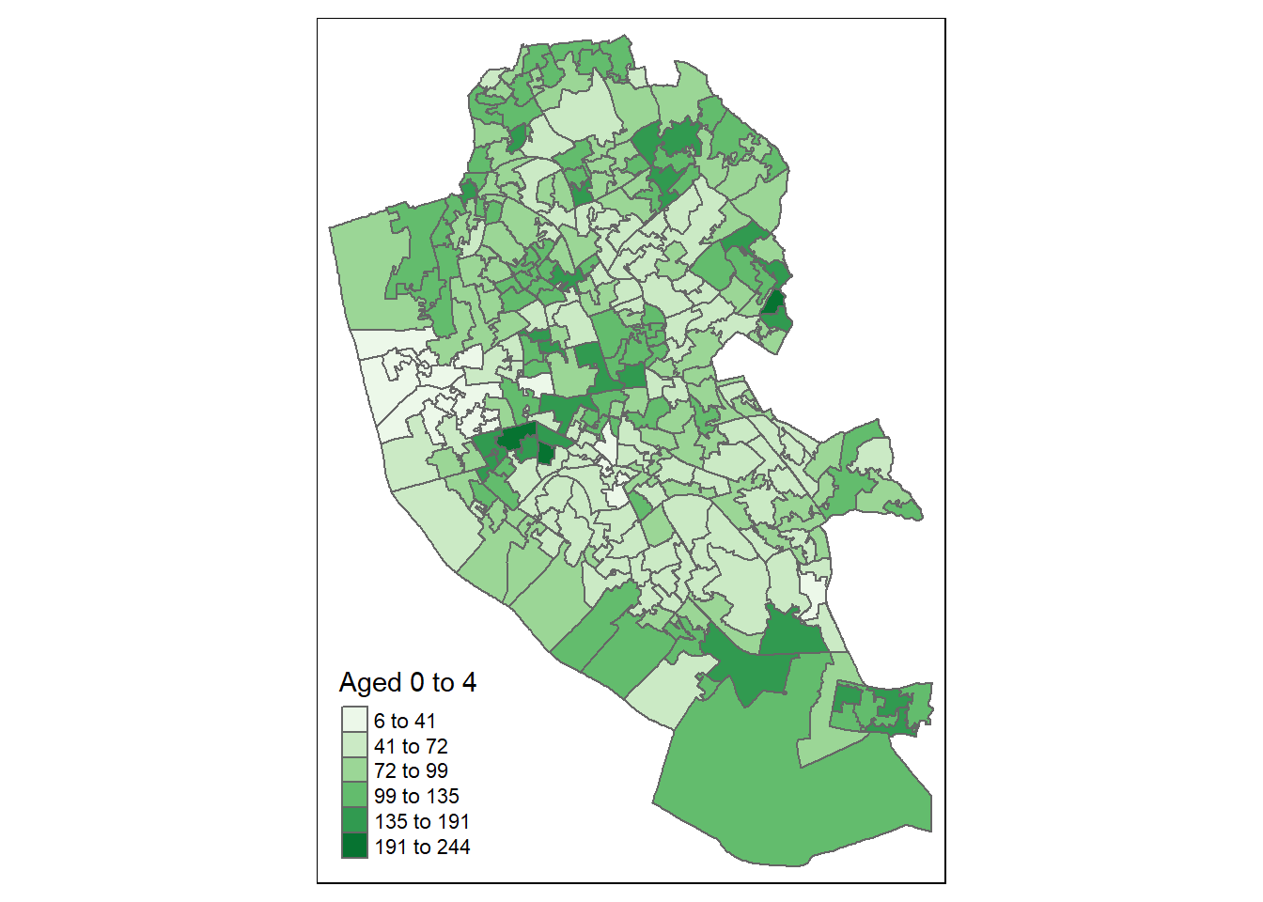
Map Design: Classification

Slide 55
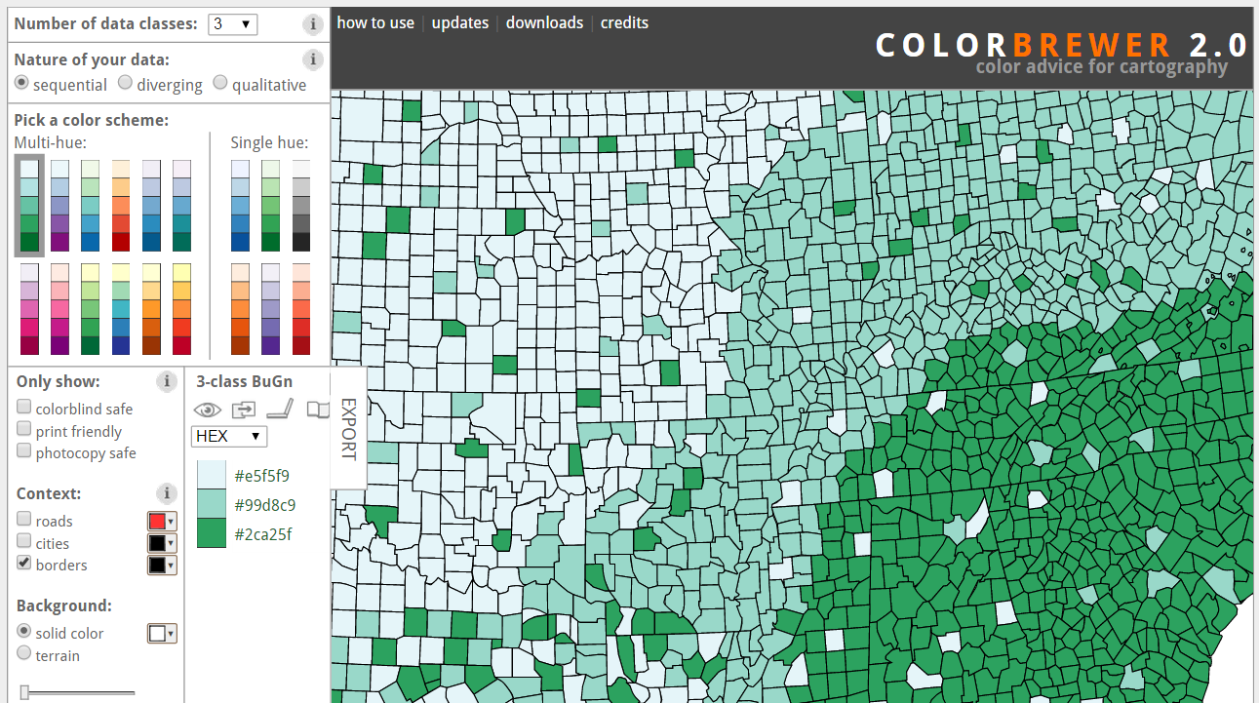
Map Design: Classification
Choropleth maps have colours
How do you choose the colours?
Why is this important?
Output
User
colorbrewer.org

Slide 56
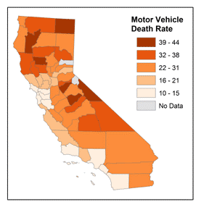
Map Design: Classification
Choropleth maps have classes
How do you choose the classes?
Why is this important?
© 2014 The Pennsylvania State University, https://www.e-education.psu.edu/geog486/l4_p7.html#classification_schemes

Slide 57
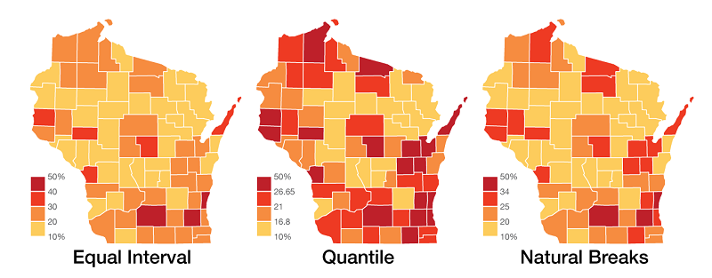
Figure 11 https://gistbok.ucgis.org/bok-topics/statistical-mapping-enumeration-normalization-classification

Slide 58
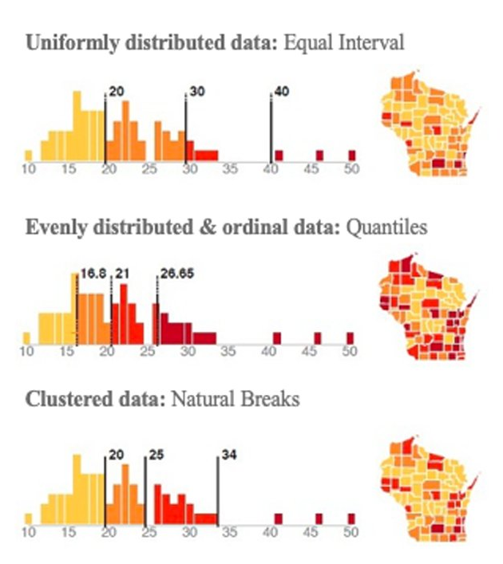
https://twitter.com/spatialanalysis/status/1224328879139147777/photo/1

Slide 59
Map Design: Classification
Many different types of breaks:
Equal Interval
Quantiles
Natural Breaks
Standard Deviation
Jenks
Unique
© 2014 The Pennsylvania State University, https://www.e-education.psu.edu/geog486/l4_p7.html#classification_schemes

Slide 60
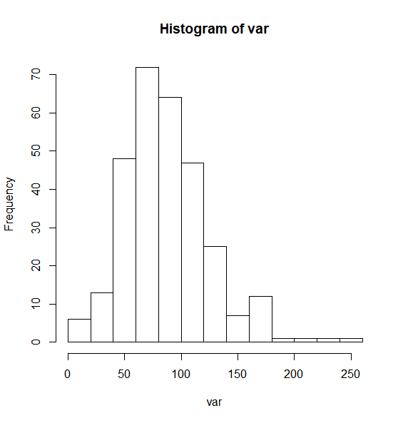
Map Design: Classification
[,"Age0to4pc"]

Slide 61
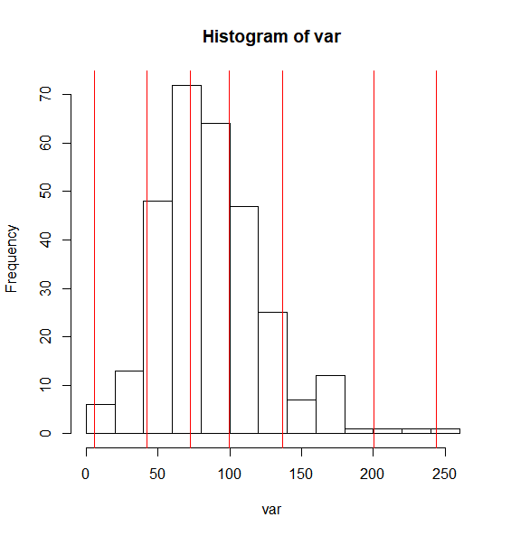
Map Design: Classification
[,"Age0to4pc"]

Slide 62
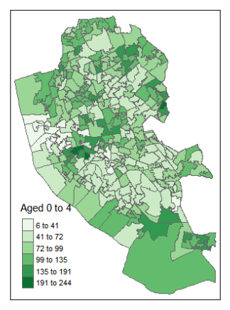
Map Design: Classification

Slide 63
Can do this in R
var <- LSOA$Age00to04

Slide 64
Can do this in R
var <- LSOA$Age00to04
library(classInt)

Slide 65
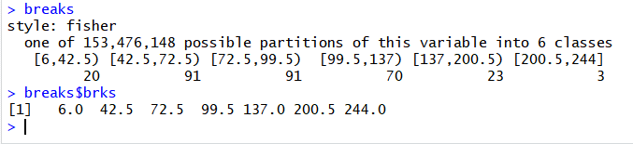
Can do this in R
var <- LSOA$Age00to04
library(classInt)
breaks <- classIntervals(var, n = 6, style = "fisher")

Slide 66
Can do this in R
var <- LSOA$Age00to04
library(classInt)
breaks <- classIntervals(var, n = 6, style = "fisher")
hist(var)

Slide 67
Can do this in R
var <- LSOA$Age00to04
library(classInt)
breaks <- classIntervals(var, n = 6, style = "fisher")
hist(var)
abline(v = breaks$brks, col = "red")

Slide 68
Code hints and tips
Useful tips
Up arrow in the console shows you the previous command
History contains a history of all commands
Plot window has a back arrow, and an export option
Tab completion
Reload libraries

Slide 69
Code debugging
R error messages can be cryptic
Remember
case sensitive
picky about , [ ] ( )
typos

Slide 70
Code debugging
R error messages can be cryptic
Remember
case sensitive
picky about , [ ] ( )
typos
Error in getinfo.shape(fn) : Error opening SHP file can’t find shapefile

Slide 71
Code debugging
R error messages can be cryptic
Remember
case sensitive
picky about , [ ] ( )
typos
Error in getinfo.shape(fn) : Error opening SHP file can’t find shapefile
Error: could not find function ”st_read” can’t find function

Slide 72
Code debugging
R error messages can be cryptic
Remember
case sensitive
picky about , [ ] ( )
typos
Error in getinfo.shape(fn) : Error opening SHP file can’t find shapefile
Error: could not find function ”st_read” can’t find function
See glossary helpsheet – and let me know what to add!

Slide 73
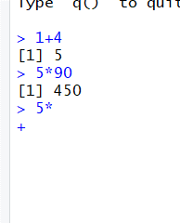
Code debugging

Slide 74
Part 2: Mapping Spatial Data in R
Part 2 of the workbook is below
Have a go working through the commands
Optional exercises – skip if you want to
Type out the code
It helps the learning process
(but you can copy/paste long bits)

Slide 76
Short Course on Using R as a GIS
Part 3: Using Loops in R
Dr Nick Bearman
@nickbearmanuk

Slide 77
Code recap
Plotting Maps
tm_shape(LSOA) + tm_polygons("Age00to04")

Slide 78
Code recap
Plotting Maps
tm_shape(LSOA) + tm_polygons("Age00to04")

Slide 79
Code recap
Plotting Maps
tm_shape(LSOA) +
tm_polygons("Age00to04",
title = "Aged 0 to 4",
palette = "Greens",
style = "jenks") +
tm_layout(legend.title.size = 0.8)

Slide 80
Code recap
Plotting Maps
tm_shape(LSOA) +
tm_polygons("Age00to04",
title = "Aged 0 to 4",
palette = "Greens",
style = "jenks") +
tm_layout(legend.title.size = 0.8)

Slide 81
Code recap
Plotting Maps
tm_shape(LSOA) +
tm_polygons("Age00to04",
title = "Aged 0 to 4",
palette = "Greens",
style = "jenks") +
tm_layout(legend.title.size = 0.8)

Slide 82
Code recap
Plotting Maps
tm_shape(LSOA) +
tm_polygons("Age00to04",
title = "Aged 0 to 4",
palette = "Greens",
n = 6,
style = "jenks") +
tm_layout(legend.title.size = 0.8)

Slide 83
Code recap
Plotting Maps
tm_shape(LSOA) +
tm_polygons("Age00to04",
title = "Aged 0 to 4",
palette = "Greens",
n = 6,
style = "jenks") +
tm_layout(legend.title.size = 0.8)

Slide 84
Code recap
Plotting Maps
tm_shape(LSOA) +
tm_polygons("Age00to04",
title = "Aged 0 to 4",
palette = "Greens",
style = "jenks") +
tm_layout(legend.title.size = 0.8)

Slide 85
Code recap
tm_shape(LSOA) +
tm_polygons(…)+
tm_scale_bar(width = 0.22, position = c(0.05, 0.18)) +
tm_compass(position = c(0.3, 0.07)) +
tm_layout(frame = F, title = "Liverpool", title.size = 2, title.position = c(0.7, "top"))

Slide 86
Code recap
tm_shape(LSOA) +
tm_polygons(…)+
tm_scale_bar(width = 0.22, position = c(0.05, 0.18)) +
tm_compass(position = c(0.3, 0.07)) +
tm_layout(frame = F, title = "Liverpool", title.size = 2, title.position = c(0.7, "top"))

Slide 87
Code recap
tm_shape(LSOA) +
tm_polygons(…)+
tm_scale_bar(width = 0.22, position = c(0.05, 0.18)) +
tm_compass(position = c(0.3, 0.07)) +
tm_layout(frame = F, title = "Liverpool", title.size = 2, title.position = c(0.7, "top"))

Slide 88
Code recap
tm_shape(LSOA) +
tm_polygons(…)+
tm_scale_bar(width = 0.22, position = c(0.05, 0.18)) +
tm_compass(position = c(0.3, 0.07)) +
tm_layout(frame = F, title = "Liverpool", title.size = 2, title.position = c(0.7, "top"))

Slide 89
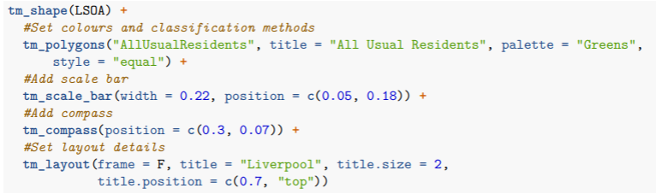
Exporting Maps
Same as before

Slide 90
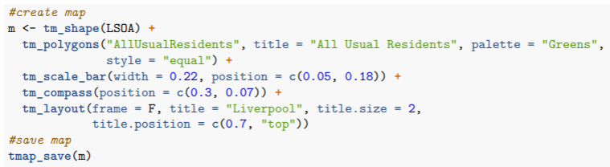
Exporting Maps
Same as before
With tmap_save(m)

Slide 91
Exporting Maps
Same as before
With tmap_save(m)

Slide 92
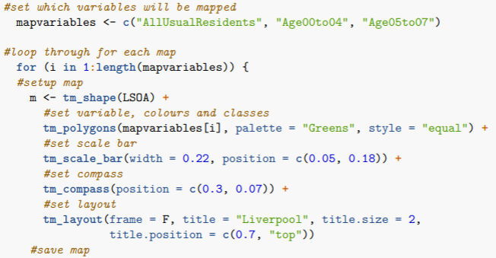
Exporting Maps
Same as before
With for () { … }

Slide 93
Exporting Maps
Same as before
With for () { … }

Slide 94
Exporting Maps
Same as before
With for () { … }

Slide 95
Exporting Maps

Slide 96
Exporting Maps

Slide 97
Exporting Maps

Slide 98
Exporting Maps
3

Slide 99
Exporting Maps
for (i in 1:3) { ...

Slide 100
Exporting Maps
i 1

Slide 101
Exporting Maps
i 1

Slide 102
Exporting Maps
i 1
mapvariables[1]

Slide 103
Exporting Maps
i 1
mapvariables[1]
“AllUsualResidents”

Slide 104
Exporting Maps
i 1
tm_polygons(“AllUsualResidents”, palette = “Greens” …

Slide 105
Exporting Maps
i 1

Slide 106
Exporting Maps
i 1
mapvariables[1]
“AllUsualResidents”

Slide 107
Exporting Maps
i 1
tmap_save(m, filename = paste0(“map-AllUsualResidents.png”))

Slide 108
Exporting Maps

Slide 109
Exporting Maps
i 2

Slide 110
Exporting Maps
i 2
mapvariables[2]
“Age00to04”

Slide 111
Exporting Maps
i 2
mapvariables[2]
“Age00to04”
tmap_save(m, filename = paste0(“map-Age00to04.png”))

Slide 112
Exporting Maps

Slide 113
Exporting Maps
i 3
mapvariables[3]
“Age05to07”
tmap_save(m, filename = paste0(“map-Age05to07.png”))

Slide 114
Exporting Maps

Slide 115
Exporting Maps
for (i in 1:3) { ...

Slide 116
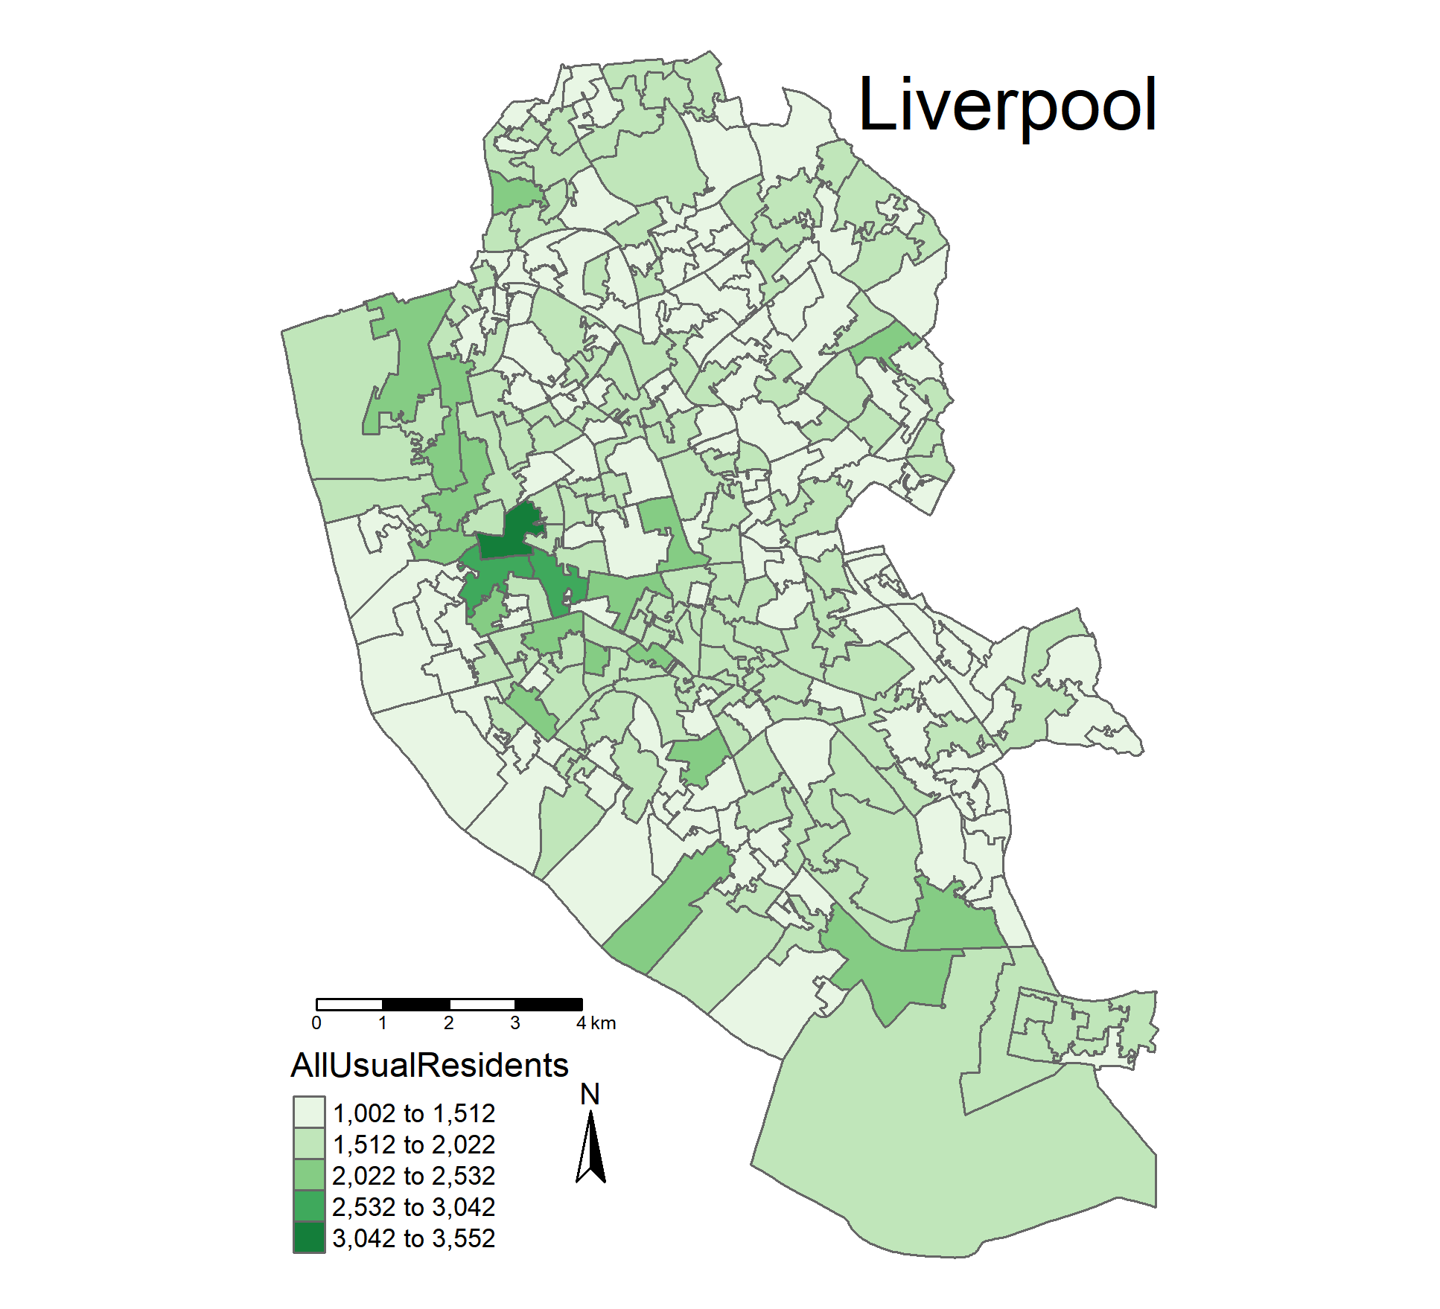
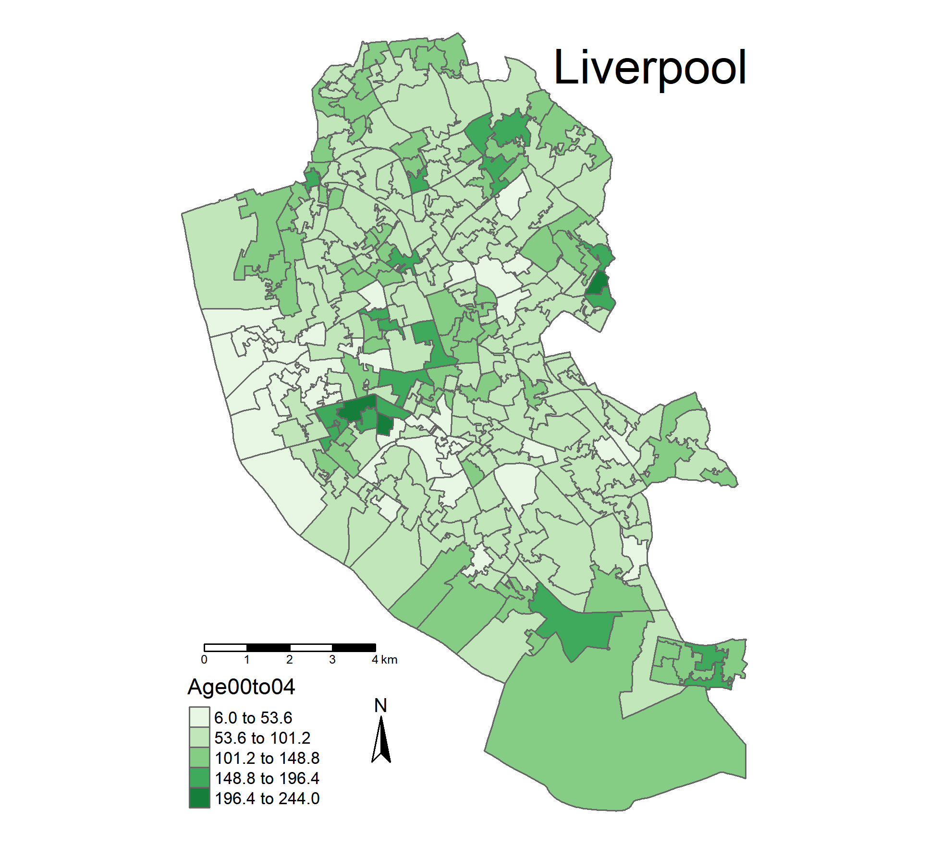
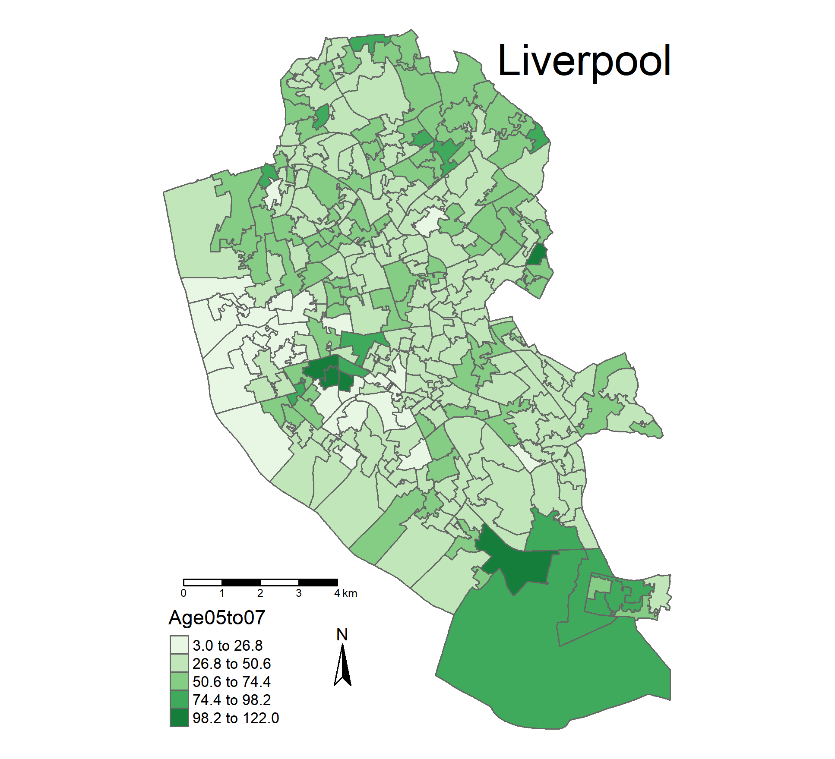
Making Maps from Census Data

Slide 117
Part 3: Using Loops in R
Part 3 of the workbook is below
Have a go working through the commands
Try experimenting with the loop code
Plot more than 3 maps
Plot different variables

Slide 119
Short Course on Using R as a GIS
Next Steps
Dr Nick Bearman
@nickbearmanuk

Slide 120
What we have done:
Three Parts:
What is R & how does it work?
Mapping Spatial data in R
Using Loops in R

Slide 121
What we have done:
Three Parts:
What is R & how does it work?
Mapping Spatial data in R
Using Loops in R
Next Steps?

Slide 122
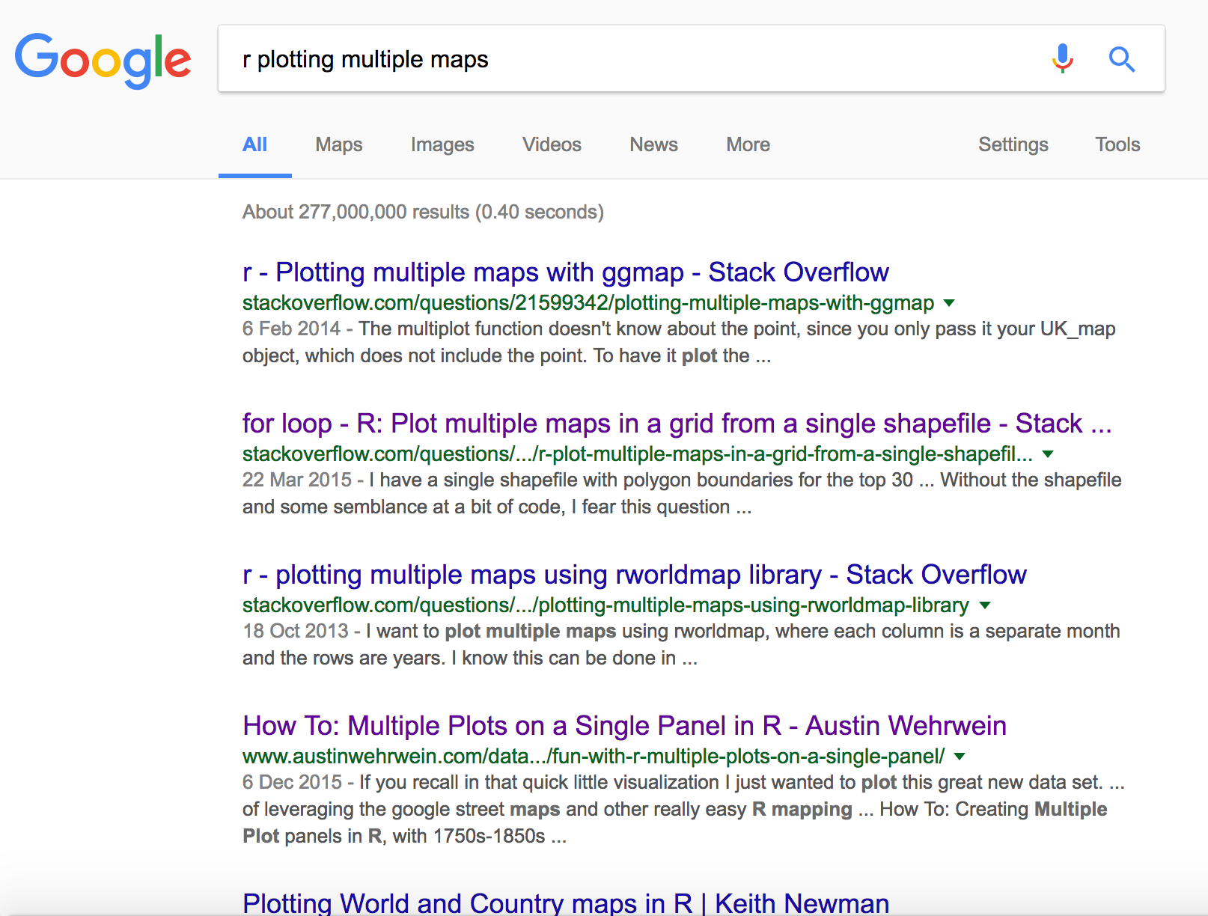

Slide 123
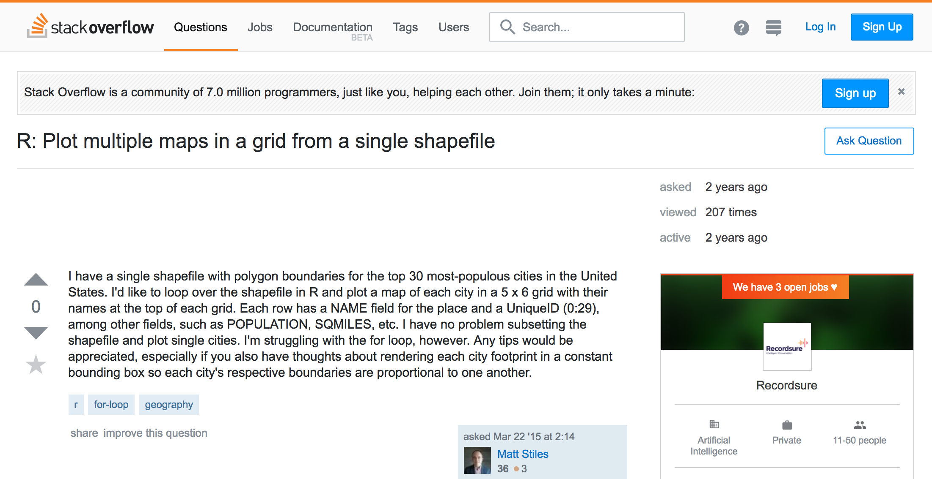
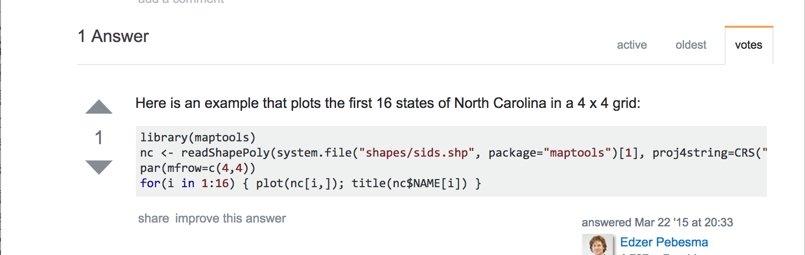
http://stackoverflow.com/questions/29190219/r-plot-multiple-maps-in-a-grid-from-a-single-shapefile

Slide 124
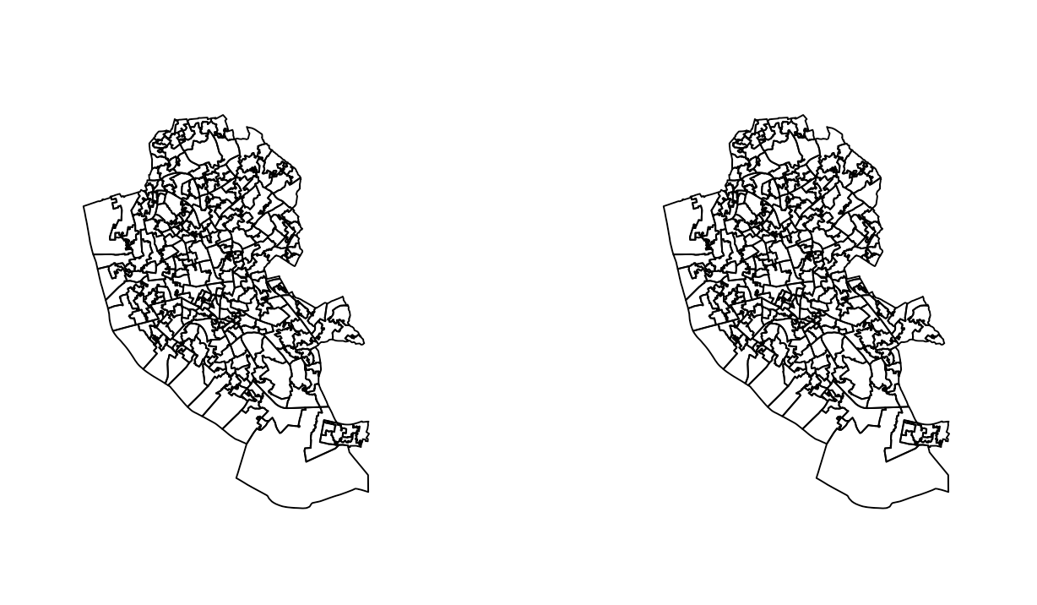
par(mfrow=c(1,2))
Plot additional rows,columns

Slide 125
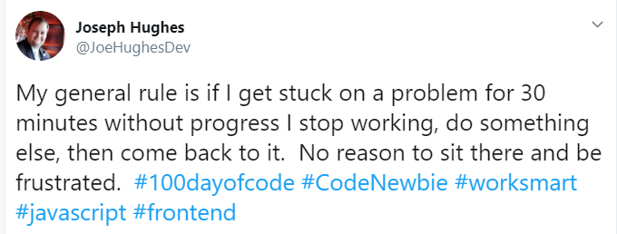
Useful Tips
https://twitter.com/JoeHughesDev/status/1127364738235674624

Slide 126

Useful Tips
https://twitter.com/JoeHughesDev/status/1127364738235674624
https://twitter.com/knatten/status/1003532557487624194

Slide 127
Useful Tips
If you get stuck on trying to work out how to code something, have a break and talk to someone.
Explain what you are trying to do (even if they don’t do programming*)
It will help you organise your thoughts, and find the bit you are missing
*You don’t even have to find a person – a cat/dog/parrot/plant will do!
https://twitter.com/JoeHughesDev/status/1127364738235674624
https://twitter.com/knatten/status/1003532557487624194

Slide 128
Useful Tips
There is usually >1 way of doing anything in R
Find a way that works for you
There is no one “right” way
Lots of libraries
plot, ggplot, tmap, …
Try ggplot if you haven’t already
Tidyverse (more of an approach than a package, sf is part of this)

